Slide 1
Introduction to Neural Networks

Slide 2
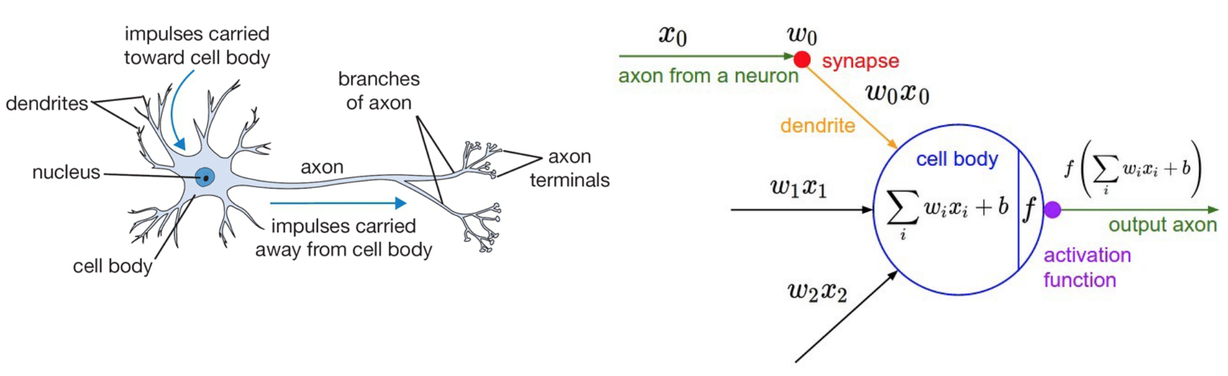
Artificial Neural Networks
If this is what comes to mind when you think "neural", you're on the right track.
The development of neural nets were inspired by the arrangement of neurons in the human brain.
The neuron's **axon** is what it uses to send signals to other neurons.
**Synapses** are sensors that receive signals from other neurons.

Slide 3
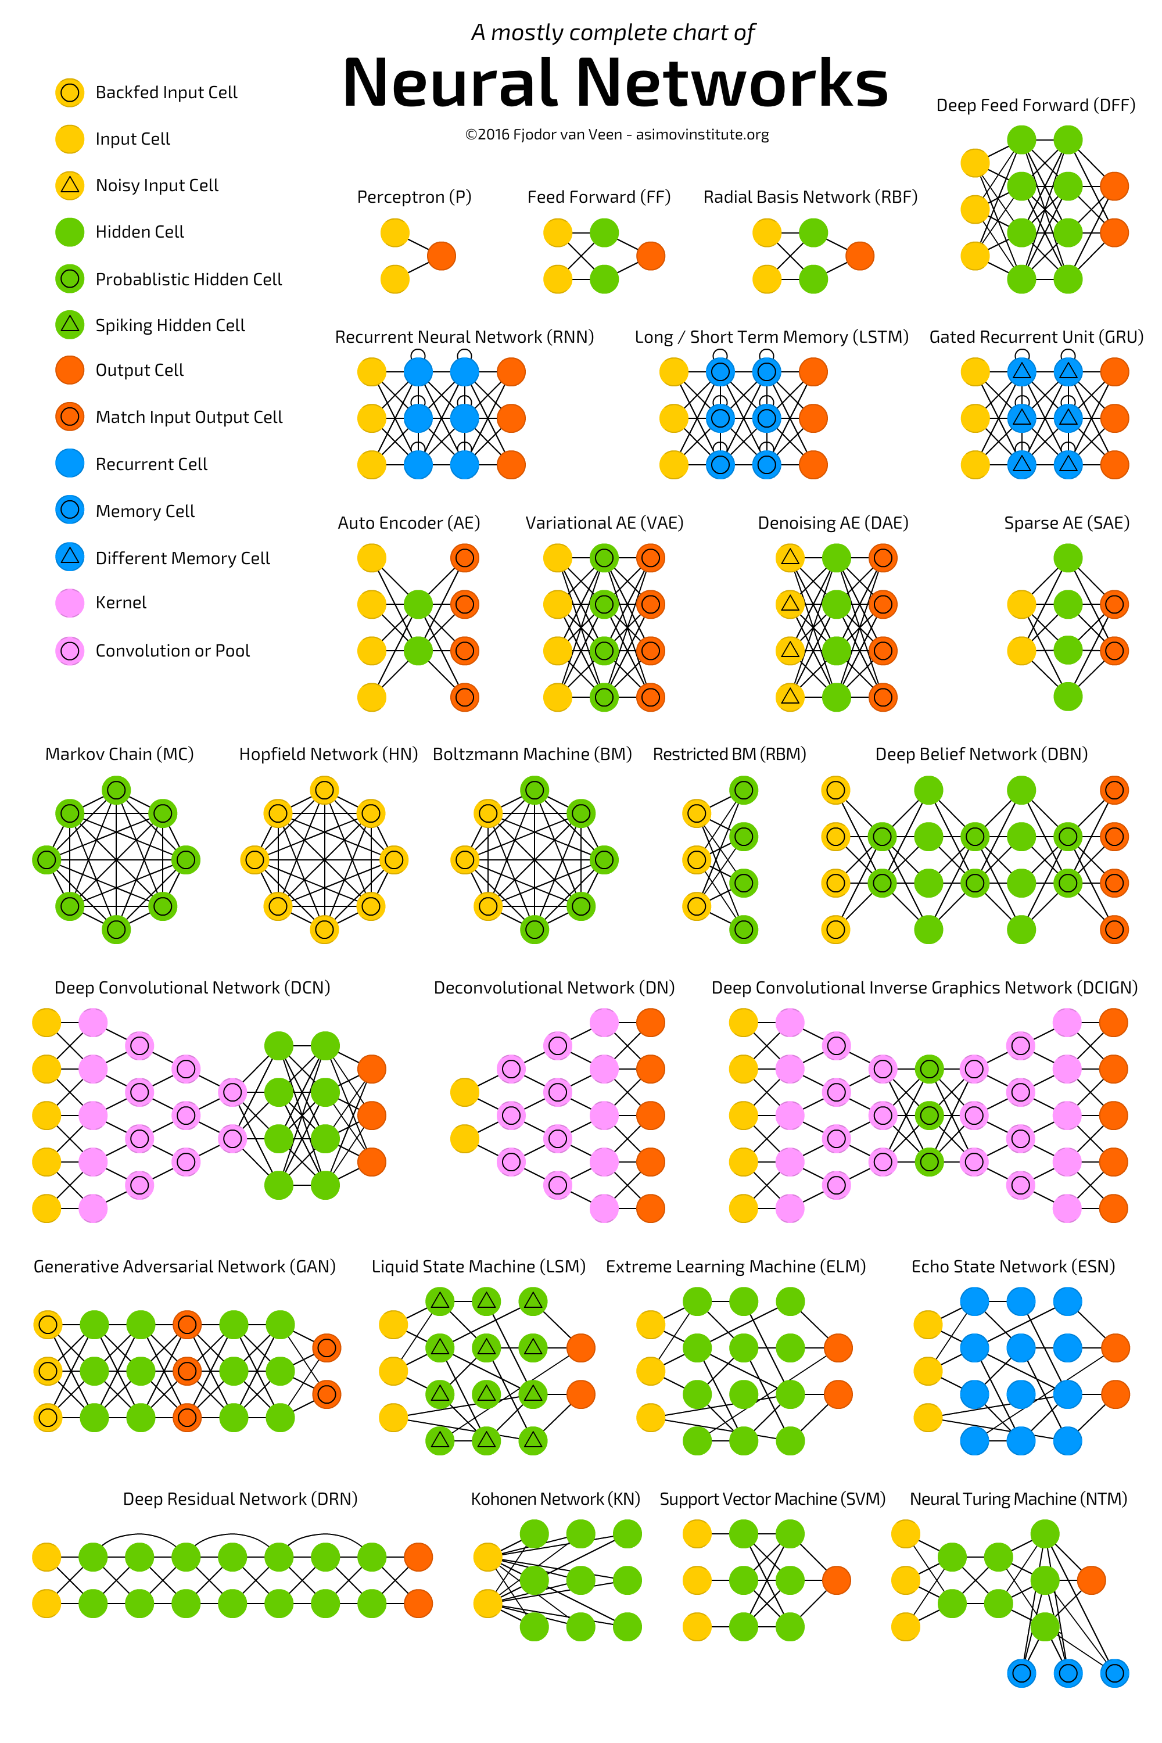
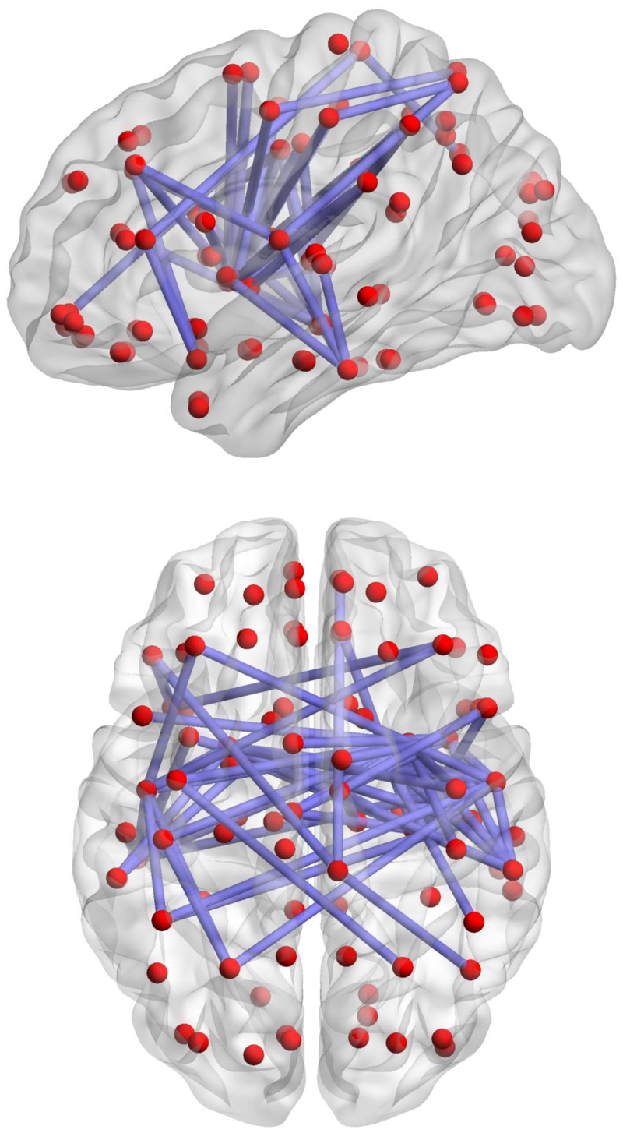
Artificial Neural Networks
The Brain
vs

Slide 4
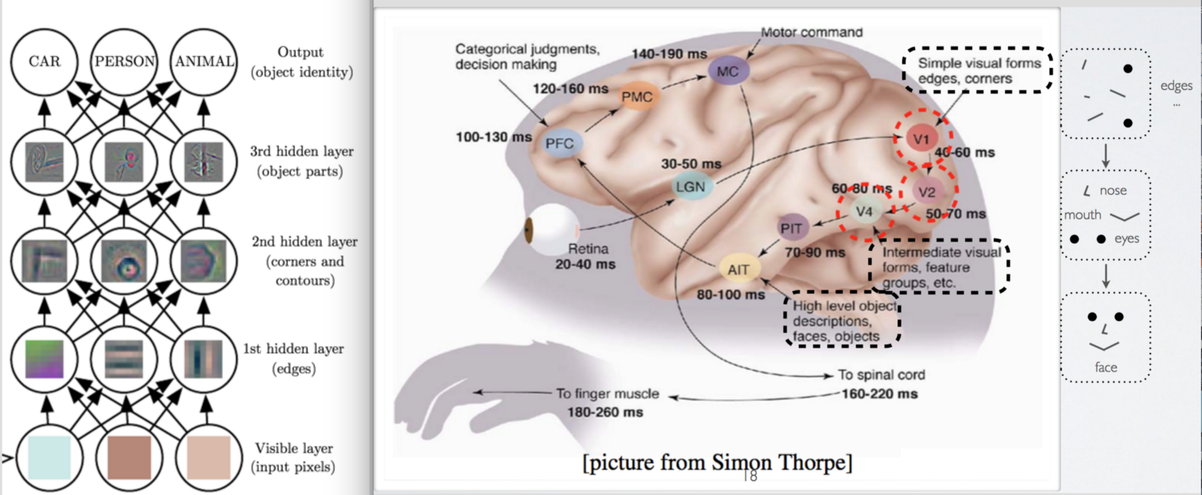
Artificial Neural Networks
As it turns out, the neural networks we program find patterns in inputs in much the same way the brain does.
As we'll see, if you understand how the brain processes visual information, you understand how neural nets process any information.

Slide 5
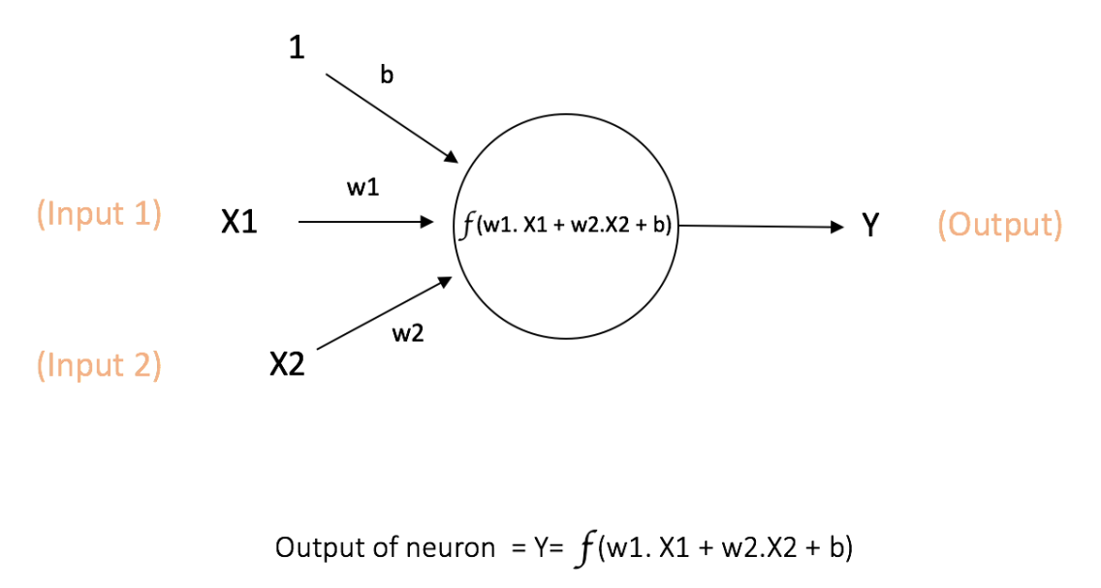
The Math...
Neurons are kinda/sorta similar to logistic regression

Slide 6
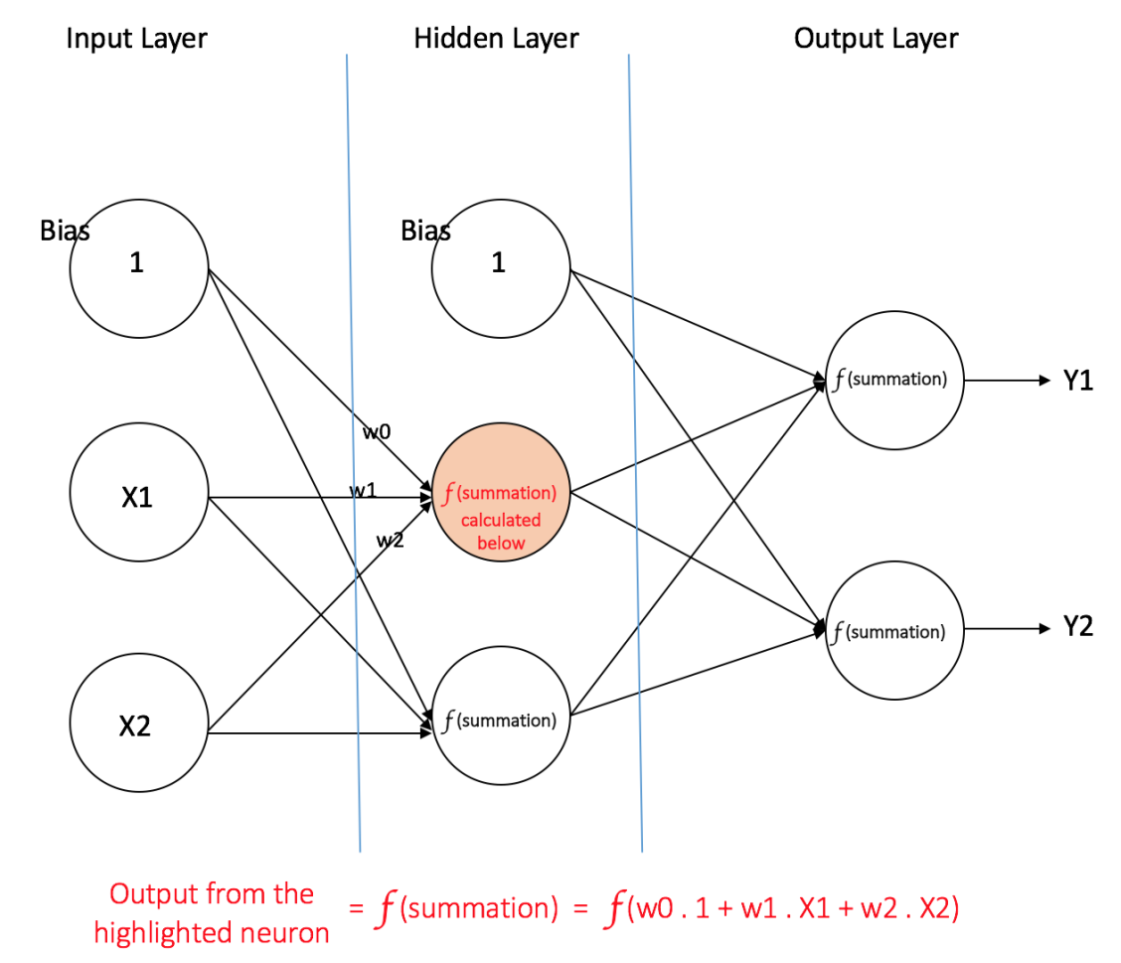
The Math...
Neural Networks are just layer of neurons connected together

Slide 7
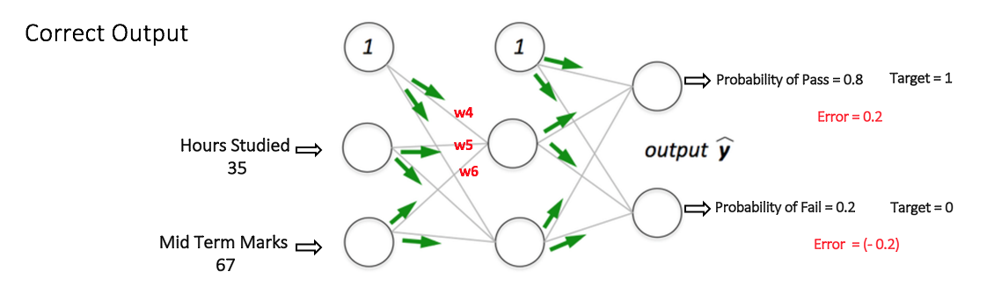
The Math...
The most important mathematical detail to understand is that neural networks typically output probabilities.
In other words, if we were to tell it how many hours we studied for a test, and our grade on the midterm, it will spit out a probability that we'll pass (or fail!...) the final.

Slide 8
How does it work?
Neural Networks are trained by feeding it (forward propagation) a bunch of inputs (like pictures of cats and dogs) and comparing the outputs to a known label (the output was a cat). The error in the output probability is then fed back (back propagation) to update the weights in each neuron. This is repeated until the NNet learns how to provide an accurate probability for a given input.

Slide 9
How does it work?
A trained neural network can take a new input (picture of a dog) and feed it through the network to predict the output label (cat or dog).
https://www.google.co.in/about/main/machine-learning-qa/

Slide 10
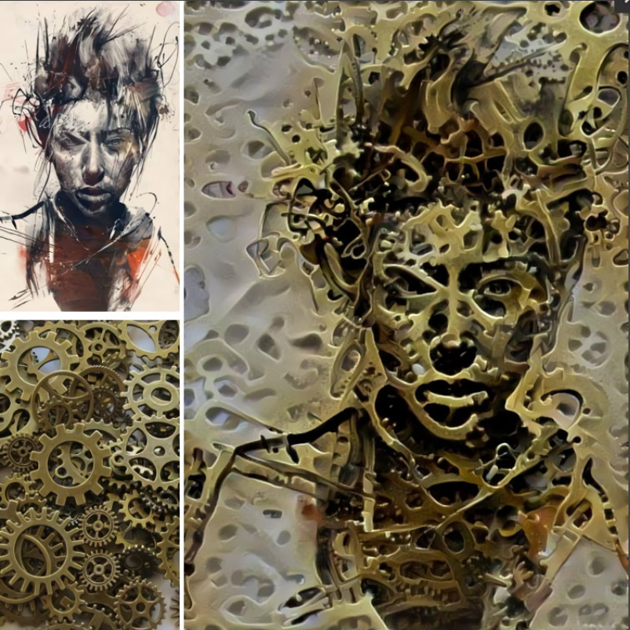
A Neural Network that merges the style of two images
https://deepdreamgenerator.com/#gallery

Slide 11
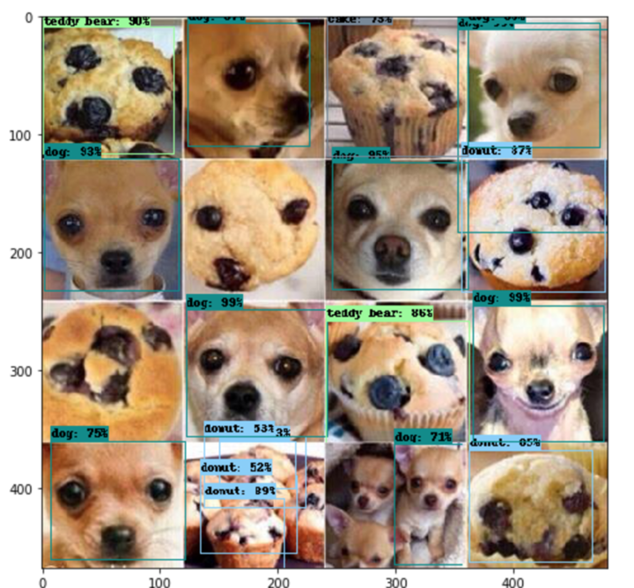
Muffin vs Dog Detector?
https://deepdreamgenerator.com/#gallery

Slide 12
Questions / Discussion
Notes:
It’s important to keep in mind why you joined this class. Let’s talk about your goals.

